Slide 1
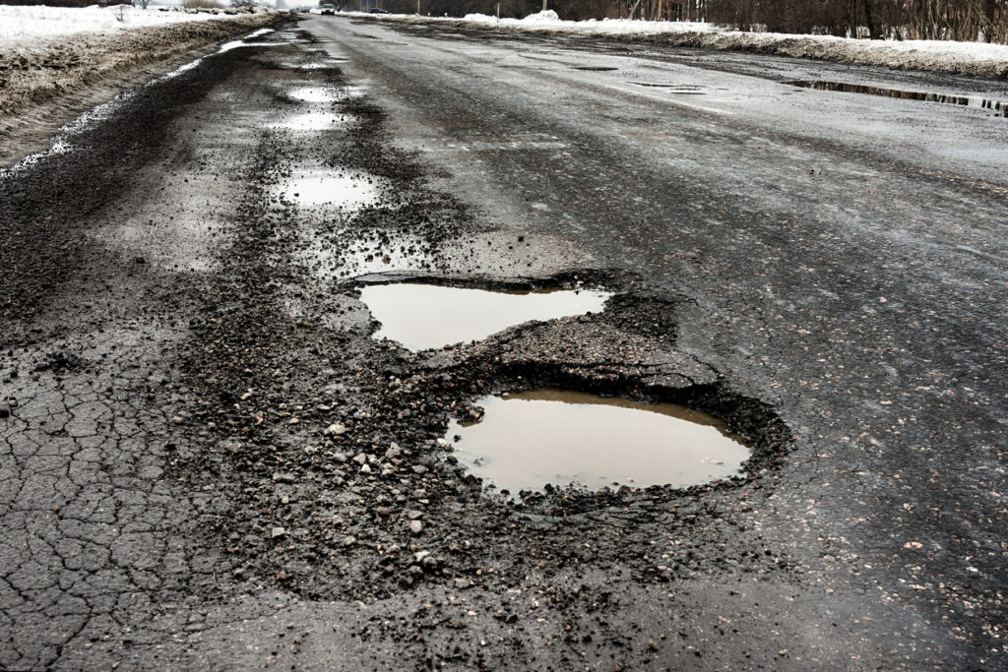
ROADS AT RISK?
DATA ANALYTICS ENHANCING HIGHWAY MAINTENANCE IN BAHRAIN
Presented By: Zainab Aloraibi

Slide 2
AGENDA
01
02
03
04
Data Overview
Introduction
Analysis
Conclusion

Slide 3

INTRODUCTION
Poor pavement conditions contribute directly to higher accident rates, making roads more dangerous and increasing the risk for all road users.

Slide 4
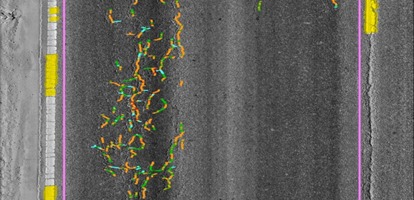
AIM
Identify pavement defects across road segments in Bahrain to support the development of an effective and data-driven road maintenance plan.

Slide 5
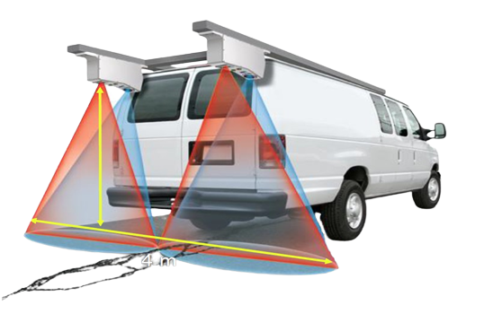
DATA OVERVIEW
The Hawkeye survey is a road assessment system that uses cameras and sensors to inspect pavement conditions. It was conducted in Bahrain during the last two weeks of December 2018, covering most major roads.

Slide 6
DATA OVERVIEW
83.95 K
Poor
5.24%
Moderate
13.05%
Good
81.71%

Slide 7
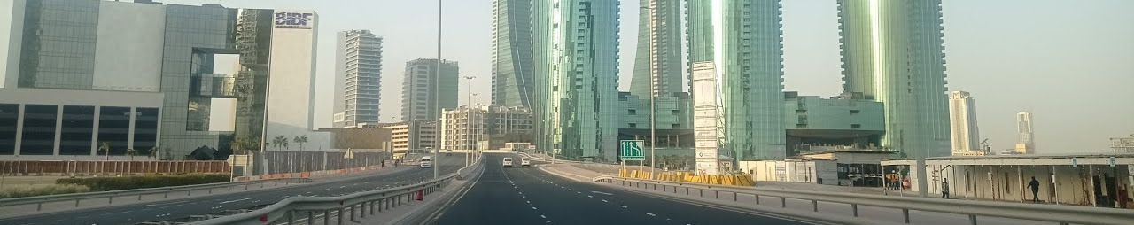
DISTRESSES
INTERNATIONAL ROUGHNESS INDEX (IRI)
Measures how smooth or rough a road is.
Low IRI = Smooth road, comfortable ride
High IRI = Rough road, uncomfortable ride

Slide 8
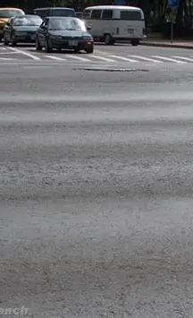
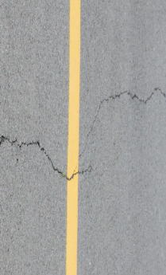
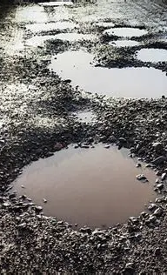
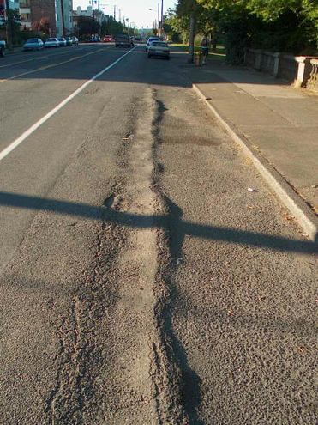
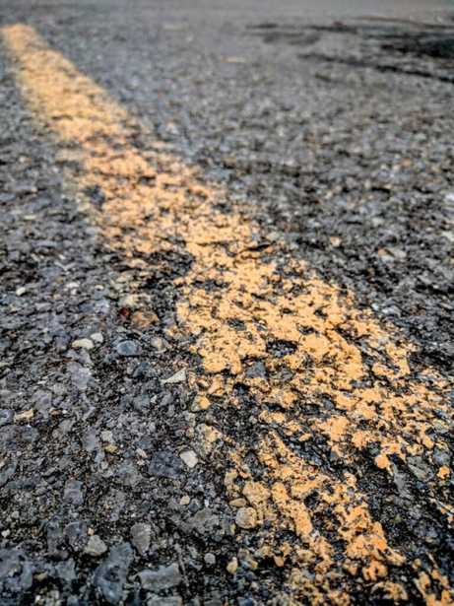
DISTRESSES
TEXTURE
CRACKS
POTHOLES
RUT
RAVELING

Slide 9
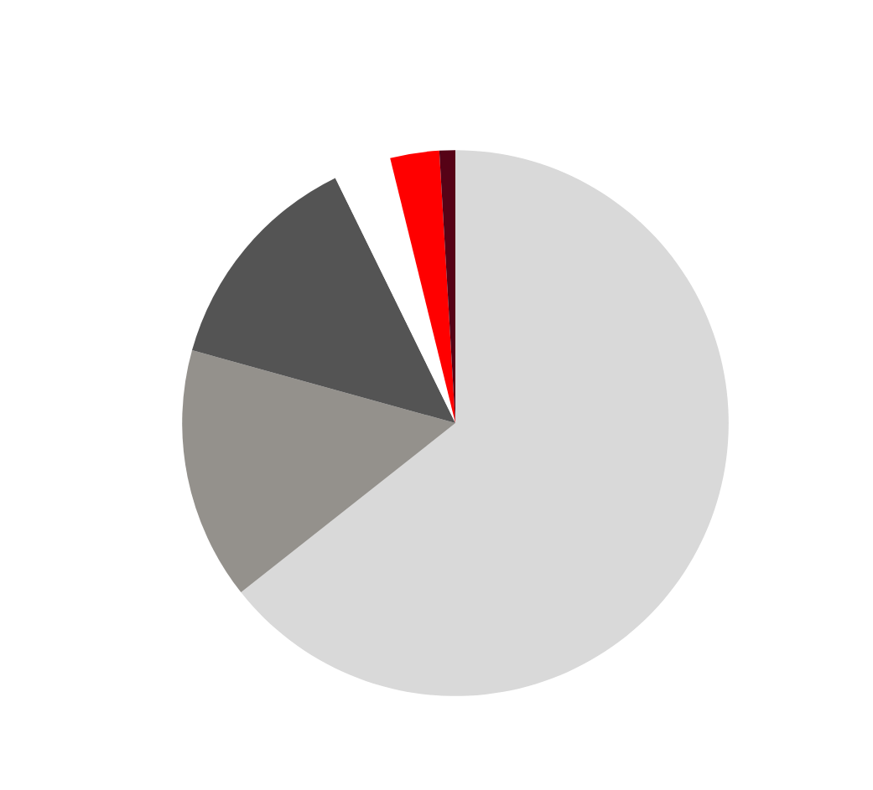
DISTRIBUTION OF DISTRESSES
The most common pavement distresses are roughness (IRI), followed by cracks and potholes.

Slide 10

4.3
4.1
RELATION BETWEEN IRI AND CRACKS
3.6
2.6
Poor pavement conditions due to cracks lead to a higher IRI, meaning a rougher ride. Good surfaces with fewer cracks have a lower IRI and smoother driving.
1.8

Slide 11
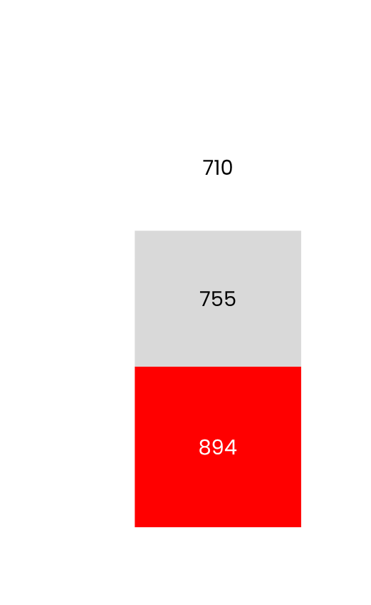
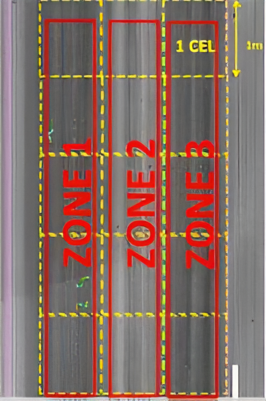
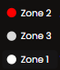
DISTRIBUTION OF POOR PAVEMENT DUE TO CRACKING ACROSS ZONES
Zone 2 has the most cracks due to heavy loads as its the main wheel path.

Slide 12

LOW SEVERITY POTHOLES ARE THE MOST COMMON

Slide 13
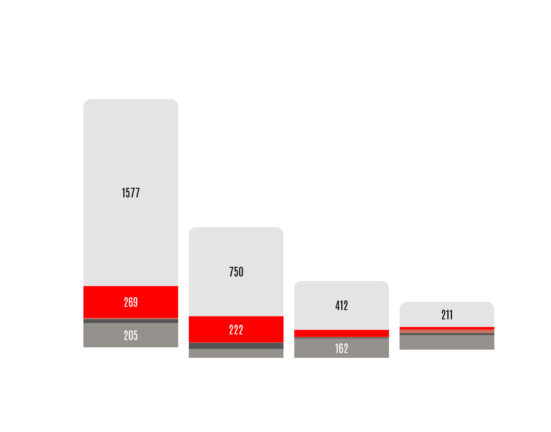
PAVEMENT DISTRESSES BY GOVERNORATE
The Capital Governorate has the highest number of road distresses due to its many old roads and consistently high traffic volumes.

Slide 14
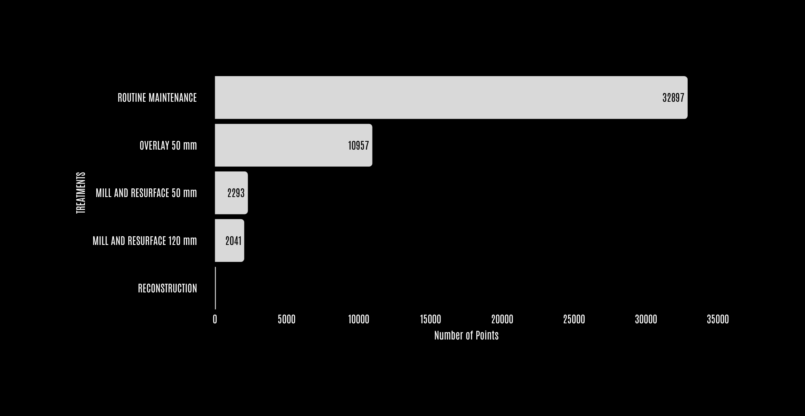
TREATMENTS

Slide 15
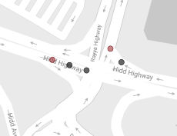
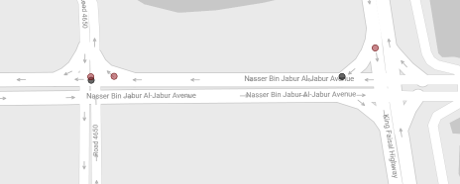
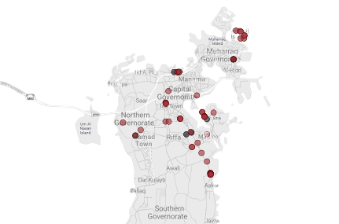
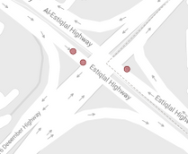
RECONSTRUCTION FOCUS AREAS
Mainly required at intersections. These areas experience frequent braking leading to higher stress on the asphalt, accelerated wear, and structural damage.

Slide 16
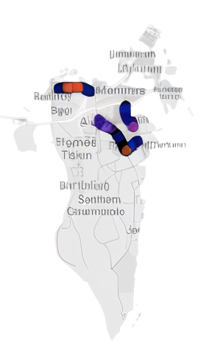

TOP 3 DETERIORATED ROADS

Slide 17
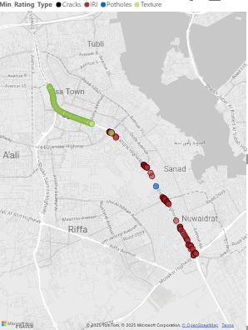
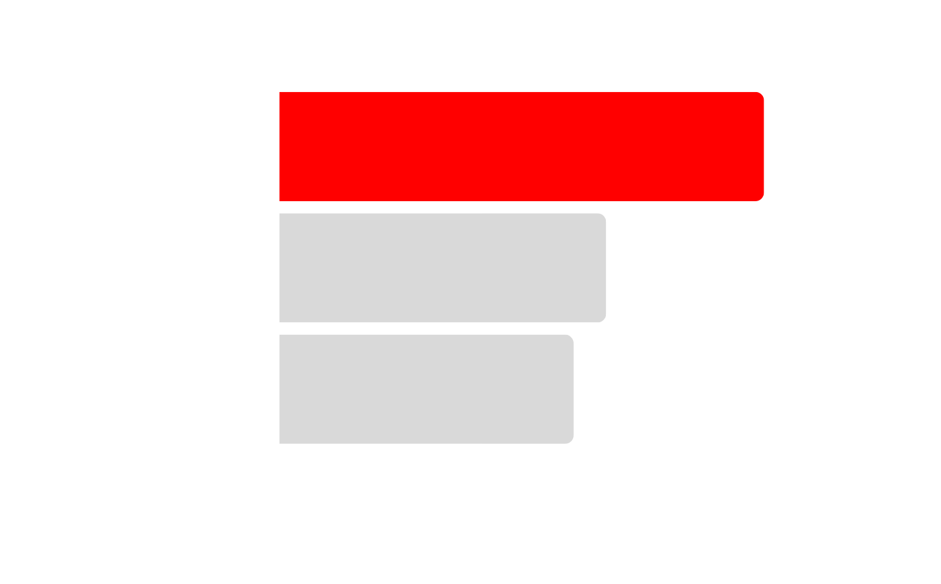
NATIONAL CHARTER ROAD

Slide 18
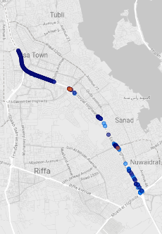

NATIONAL CHARTER ROAD

Slide 19
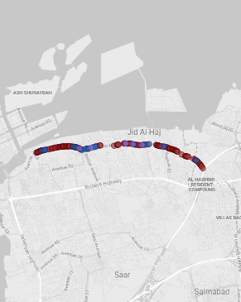

ALNAKHEEL HWY

Slide 20
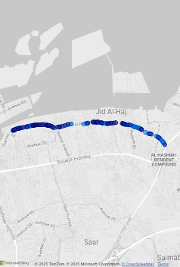

ALNAKHEEL HWY

Slide 21
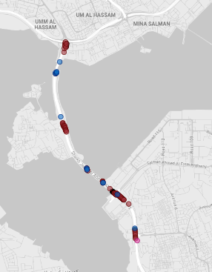
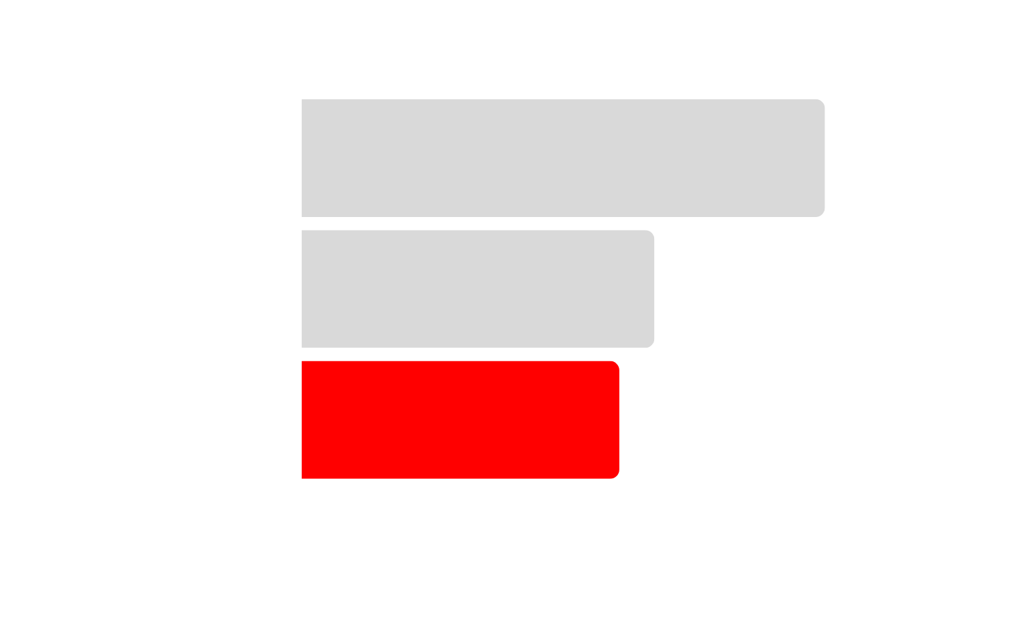
SHAIKH JABER A. AL SUBAH HWY

Slide 22
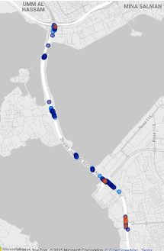

SHAIKH JABER A. AL SUBAH HWY

Slide 23
CONCLUSION
Prioritize maintenance in the Capital Governorate due to its highest pavement distress There.
Focus on Zone 2, the most deteriorated Zone. Prioritize crack repair, as it raises IRI and lowers ride quality.
Use interlocking pavers at intersections for easier maintenance, and high-strength concrete in high-traffic areas for greater durability.

Slide 24
THANK YOU

